Slide 1
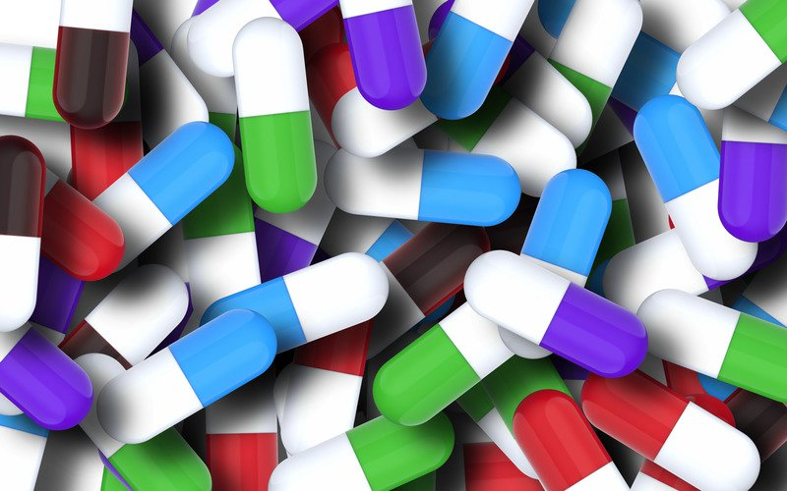
Mr.doc
“Healthy India Wealthy India”

Slide 2
Introduction:-
It is mobile (android) based application. Our app is health related app by which you can get symptoms, cure, nearby hospitals & doctors and various other information to live your healthy life.

Slide 3
Features:
Search any disease by its symptoms
A friendly messenger to talk with doctors and other patients.
Artificial intelligent based Chatbot.
Social forum to share thoughts via post sharing.
Near by locations of hospitals
Transfer medium for various medical reports
Animal help center .
Provides best personal take care nurses.
A healthometer to keep your daily health record.

Slide 4
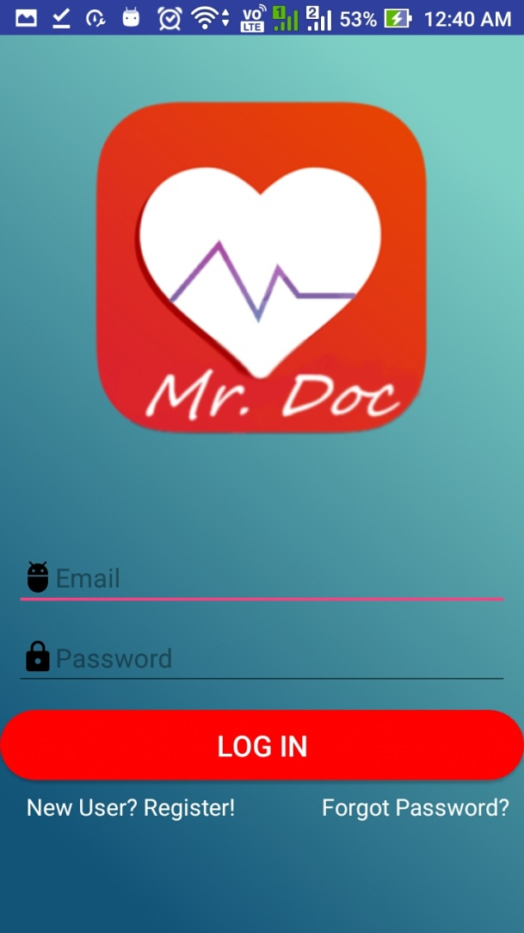
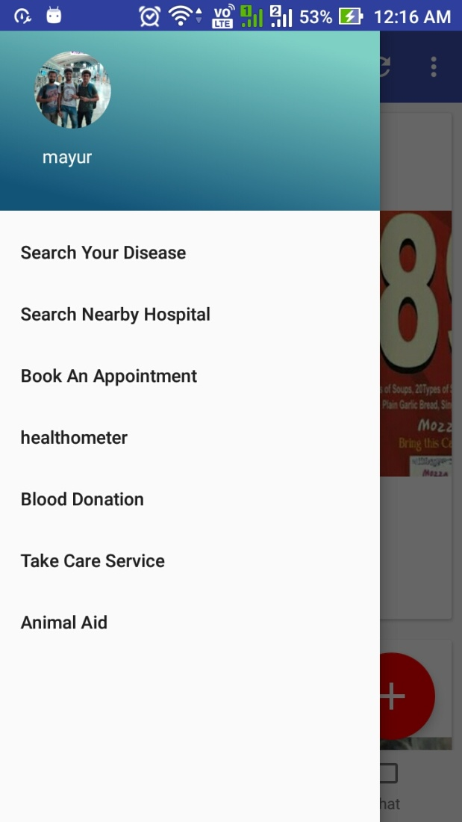
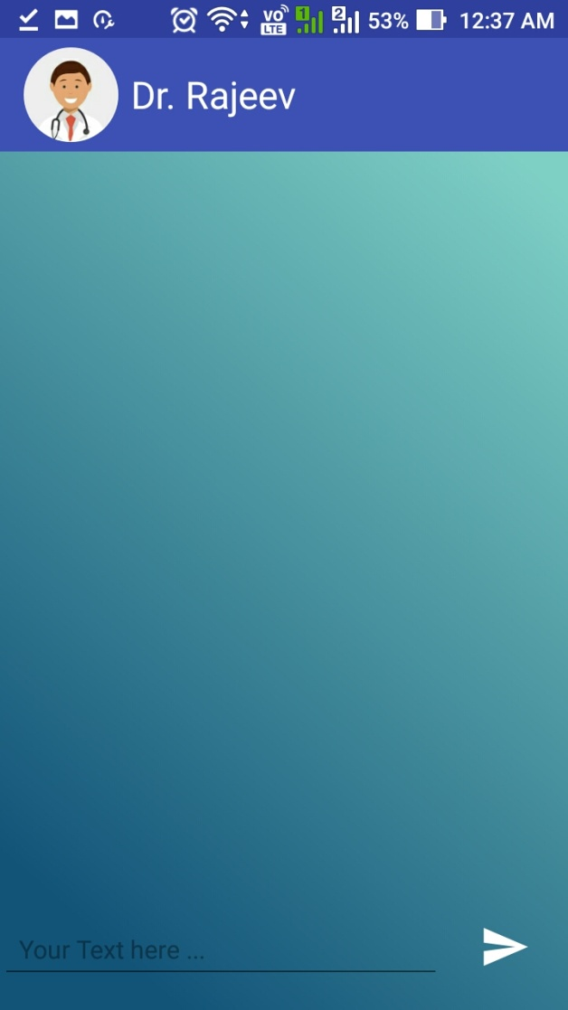
Prototype:

Slide 5
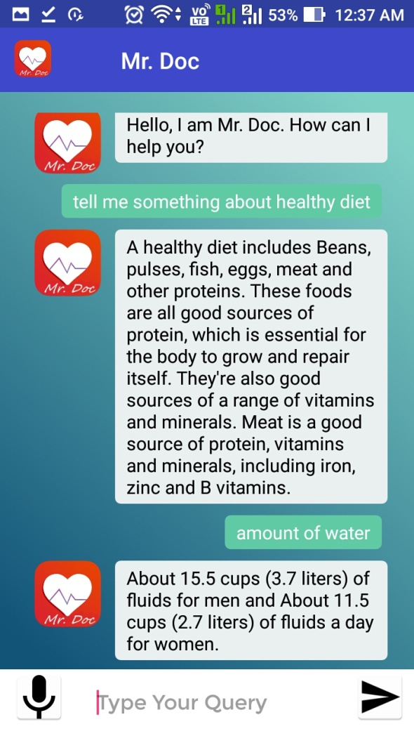
Chatbot:
This chatbot is one of
the main attraction
of our project.This is our
Mr.Doc from which
You can talk on several
medical issues.

Slide 6
By our app You can:
1.Search any disease by its symptoms or by name directly and find information like:-
(i) All possible disease name related to symptoms
(ii) All possible symptoms of selected disease
(iii) Precautions and cures for that disease
(iv) Suggested Doctors nearby
(v) Medicines described
(vi) Hospitals nearby
(vii) Take an appointment to Doctor Selected
(viii) Contact information of suggested Doctor and Hospitals
(ix) Location of Hospitals and route

Slide 7
2. Find common diseases availing in Environment:-
(i) Disease affecting our health availing in present environment
(ii) Symptoms , Precautions and Cure for them
(iii) What to do if affected?

Slide 8
3. Messenger:
By chatting with others including doctors and patients can help you find better possible cures for your diseases.
4. ChatBot:
It is A.I based Doctor which will answer your disease related questions.

Slide 9
5.Healthometer:
Live a healthy day by tracking your daily activities and improving them in healthy way .
By this:-
I. You can mark your daily activities and can set reminder for healthy activities like jogging, daily doses of medicines, milk etc and much more to live a healthy day.
II. It will suggest better meals for you to consume for healthy body. Better for those who are suffering from diseases like diabetes.
III. It will help you maintain your sugar level by suggesting you better meals for you to consume.
IV. It will help woman at their pregnancies to avoid any possible problems.
*Health related videos
*Track your daily sleep
*Yoga and meditation tips.

Slide 10
6. Post sharing:
You can share your posts and can get posts regarding other diseases and thus find their cures through comments on post by other who are suffering or who that suffered and cured. Thus someone suffering from
such diseases can find others suffering from same disease and thus can
get help and can help others too. Local doctors using this app will also
share their posts to like blood and others could bemake our India healthy. Also various requirements shared and thus it could be met by the people who want to help for the people seeking help.

Slide 11
7. Take an appointment:
You can find doctor depending on your choices whether you want skin doctor, dentist.
Our app will help you to find nearby doctor and you can book an appointment. It will also
Set reminder for appointment and it will help you by avoiding you to miss it.

Slide 12
8. Donate for good:
It will assist you to find and get reminder for various donation camp nearby to do good & help others.
9. Animal aid:
Last but not least it includes animal aid too. By this you can inform animal aid regarding any disease through which any animal in your locality is suffering by &thus they can help that animal too.

Slide 13
Benefits:
it becomes a bridge between patients and doctors.
learns from others experience.
lesser medical frauds as data is in the system it becoms next to impossible to forge.
keep your daily health record.
get nearby hospitals location
provides a transfer medium for several medical reports.
provides jobs for nursing freshers.

